Slide 1

CSC364-Software Engineering Week-2 Lecture-4 Semester-# Fall 2018
Prepared by:
M. Sajid Farooq

Slide 2
Instructor Contact Details
Name: M. Sajid Farooq
Course Instructor: CSC364- Software Engineering
Credit Hours: 3
Designation : Lecturer
Office Location: CS-Staff Room Cabin Sr#15
Email: msajidfarooq@lgu.edu.pk
Visiting Hours: Monday- Tuesday (1430-1600)
Lab Work: Video Tutorials & Supervision by Instr

Slide 3
Course Objectives
The main objective of this course is to provide a detailed view to Software Engineering and related topics.
The students will learn about the technical as well as the management side of Software Engineering.
They will acquire knowledge about fundamental principles of Software Engineering and also about practical approaches to securing Software Engineering.
Moreover, students should be able to work on UML and Software Engineering.

Slide 4
What is Software Process
When you work to build a product or system, it’s important to go through a series of predictable steps
A road map that helps you create a timely, high-quality result.
The road map that you follow is called a “software process.”

Slide 5
Who does it?
Software engineers and their managers adapt the process to their needs and then follow it.
The people(stakeholders) who have requested the software have a role to play in the process of defining, building, and testing it.

Slide 6
SDLC
SDLC, Software Development Life Cycle is a process used by software industry to design, develop and test high quality software.
The SDLC aims to produce a high quality software that meets or exceeds customer expectations, reaches completion within times and cost estimates.
SDLC is also called as Software development process

Slide 7
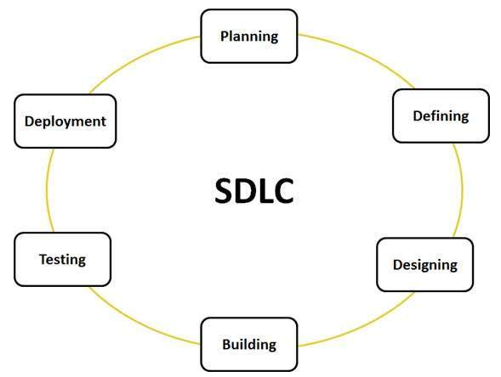
A typical SDLC

Slide 8
Most popular SDLC models
Build and Fix Model
Waterfall Model
Rapid Prototyping Model
Incremental Model
Synchronized and Stable Model
Rapid Application Model
Spiral Model
Fountain Model

Slide 9
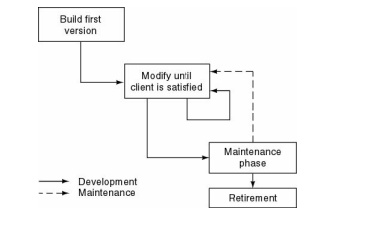
Build and Fix Model

Slide 10
Waterfall Model
Waterfall approach was first SDLC.
In "The Waterfall" approach, the whole process of software development is divided into separate phases.
Typically, the outcome of one phase acts as the input for the next phase sequentially.
Requirements are very well documented, clear and fixed.
Product definition is stable.
Technology is understood and is not dynamic.
There are no ambiguous requirements.
The project is short in duration.

Slide 11
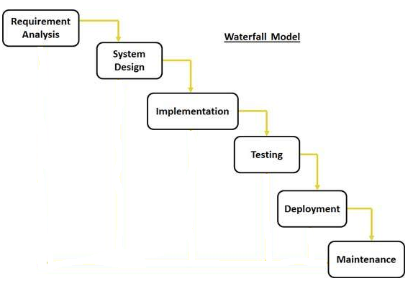
Waterfall Model

Slide 12
Phases-Waterfall Model
Requirement Gathering and analysis
System Design
Implementation
Integration and Testing
Deployment of system
Maintenance

Slide 13
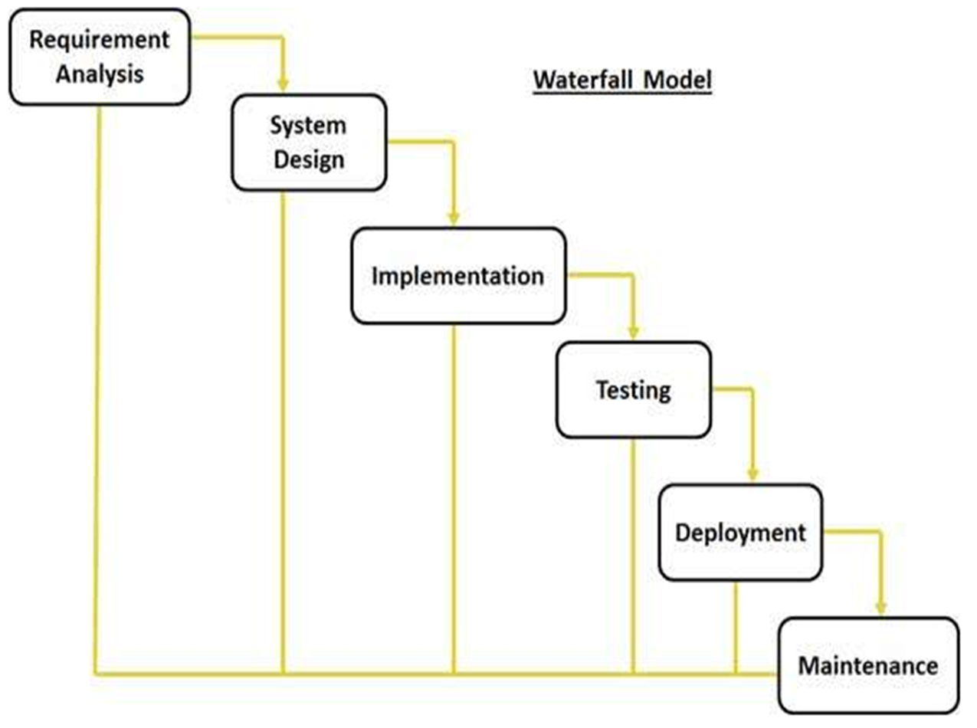
Phases-Waterfall Model

Slide 14
Waterfall Model Pros
Simple and easy to understand and use
Easy to manage due to the rigidity of the model . each phase has specific deliverables and a review process.
It allows for departmentalization and control.
Phases are processed and completed one at a time.
Works well for smaller projects where requirements are very well understood.
Clearly defined stages.
Easy to arrange tasks.
Process and results are well documented.

Slide 15
Waterfall Model Cons
High amounts of risk and uncertainty.
Not a good model for complex and object-oriented projects.
Poor model for ongoing projects.
Not suitable for the projects whose requirements are at a moderate to high risk of changing.
Adjusting scope during the life cycle can end a project.

Slide 16
The End

Slide 17
Q & A

Slide 18
References
These lecture notes were taken from following source:

